Slide 1
Visit to Penn State
Dec. 16-19 2015

Slide 2
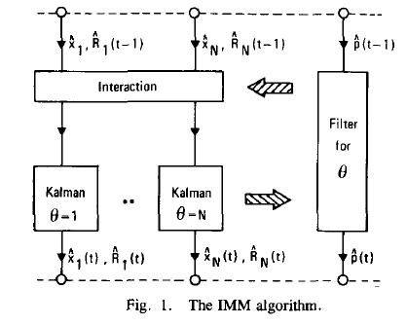
IMM history
Henk A. P. Blom And Yaakov Bar-shalom. “The Interacting Multiple Model Algorithm for Systems
with Markovian Switching Coefficients.” IEEE Transaction on Automatic Control, 1988.

Slide 3
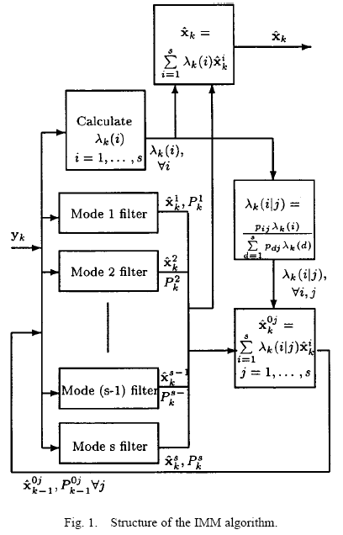
IMM history
Leigh A. Johnston and Vikram Krishnamurthy. “An Improvement to the Interacting Multiple Model
(IMM) Algorithm.” IEEE Transactions on Signal Processing, 2001.

Slide 4
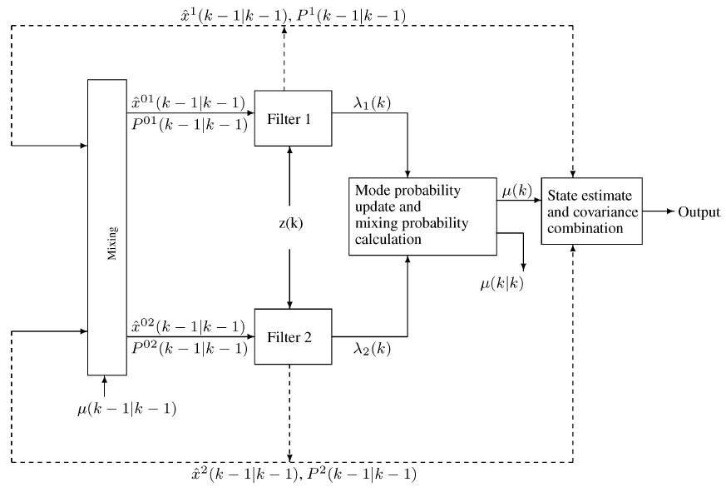
IMM history
Thuraiappah Sathyan and Thiagaligam Kirubarajan. “Markov-Jump-System-Based Secure Chaotic Communication”. IEEE Transactions on Circuits and Systems, 2006.

Slide 5
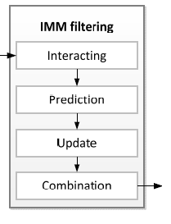
IMM structure
Taehwan Cho, Changho Lee and Sangbang Choi. “Multi-Sensor Fusion with Interacting Multiple Model Filter for Improved Aircraft Position Accuracy.” Sensors, 2013.

Slide 6
IMM structure
Kalman Filters
Taehwan Cho, Changho Lee and Sangbang Choi. “Multi-Sensor Fusion with Interacting Multiple Model Filter for Improved Aircraft Position Accuracy.” Sensors, 2013.

Slide 7

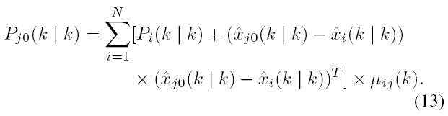
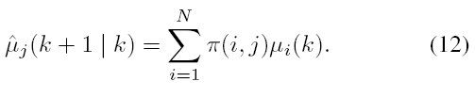

IMM equations
Mixing/Interaction

Slide 8

IMM equations
Prediction

Slide 9

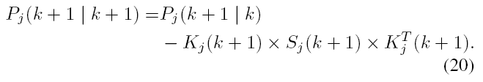
IMM equations
Update

Slide 10
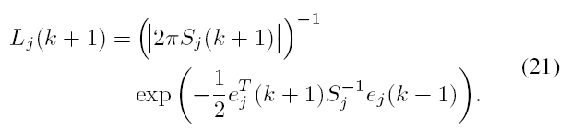

IMM equations
Likelihood/ mode probabilities update

Slide 11

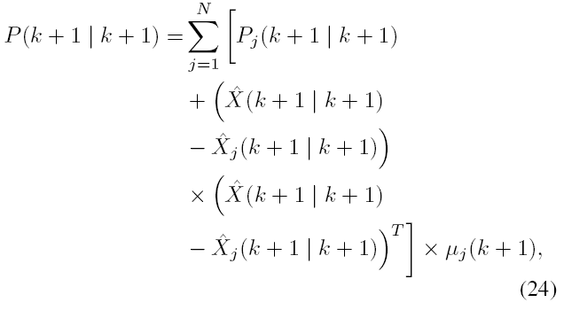
IMM equations
IMM outputs

